Slide 1


K.RAMAKRISHNAN COLLEGE OF TECHNOLOGY
(AUTONOMOUS), TRICHY.
VISITOR MANAGEMENT SYSTEM
PRESENTED
Name of the Student: DEVICHARAN P
Reg No.:2303811710421023
SUPERVISOR
Mr. M. Saravanan, M.E.,
AP/CSE.

Slide 2
PRESENTATION OVERVIEW
Objective
Project Introduction
Problem Statement
Methodologies (Programming concepts relevant to problem statement)
Architecture of the proposed system
List of Modules
Merits
Results and Discussion
Queries

Slide 3
OBJECTIVE
Primary Objective:The Objective Of A Visitor Management System (VMS) Is To Enhance Security, Improve Efficiency, And Provide A Seamless Visitor Experience While Ensuring Proper Documentation And Compliance. Key Objectives Include.
Key Goals:
Facilitate Emergency Response
Integrate with Other Systems
Enhance Visitor Experience
Centralize Management

Slide 4
PROJECT INTRODUCTION
Visitor management is crucial for maintaining security and organization within any facility. This Java-based Visitor Management System aims to streamline the process of managing visitor information, ensuring accurate records and easy access to visitor data.

Slide 5
PROBLEM STATEMENT
Security Concerns
Unauthorized Access: Difficulty in preventing unauthorized individuals from entering the premises.
Lack of Visitor Tracking: Inability to track who is on-site at any given time, posing security risks.
2. Inefficient Check-In/Check-Out Processes
Manual Processes: Time-consuming manual entry of visitor details, leading to long wait times.
Human Errors: Mistakes in recording visitor information due to manual processes.

Slide 6
METHODOLOGIES
Requirement Analysis:
  Identified the key requirements, such as visitor registration, tracking, searching, and updating, to ensure the system meets organizational needs.
Design and Planning:
  Developed a modular design for scalability and efficiency, dividing the system into functional components like registration, management, and search modules.
GUI Development:
  Used Java Swing to create an interactive and user-friendly interface for seamless user interaction.
Data Handling:
  Implemented dynamic data management using ArrayList to store and manipulate visitor records in real-time.

Slide 7
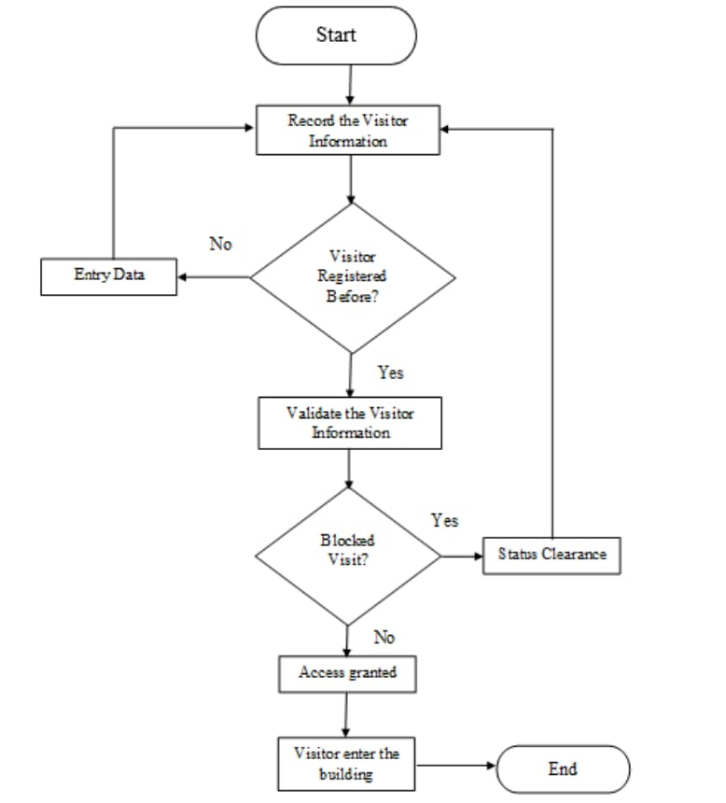
ARCHITECTURE OF THE PROPOSED SYSTEM

Slide 8
LIST OF MODULES
MODULE DESCRIPTON
1.Visitor Registration ModuleDescription: This module manages the process of visitor registration. It allows for both pre-registration (before arrival) and on-site registration.
2.Visitor Badge Printing ModuleDescription: Automatically generates a visitor badge that includes essential information such as the visitor’s name, photo, time of visit, and the person they are visiting.
Key Features:Data encryption and secure storage of visitor informationAutomatic deletion of visitor data after a certain periodIntegration with watchlists or banned visitor lists

Slide 9
MERITS
Streamlined Registration: Simplifies visitor registration with automated unique ID assignment.
Real-Time Tracking: Tracks check-in and check-out statuses for accurate monitoring.
Data Organization: Maintains structured visitor records for easy access and management.
Search Functionality: Enables quick retrieval of visitor details by name.
Scalability: Supports dynamic data handling using Java's ArrayList.
Sorting and Filtering: Allows sorting by name or ID and filtering by status.
User-Friendly Design: Features an intuitive GUI built with Java Swing.

Slide 10
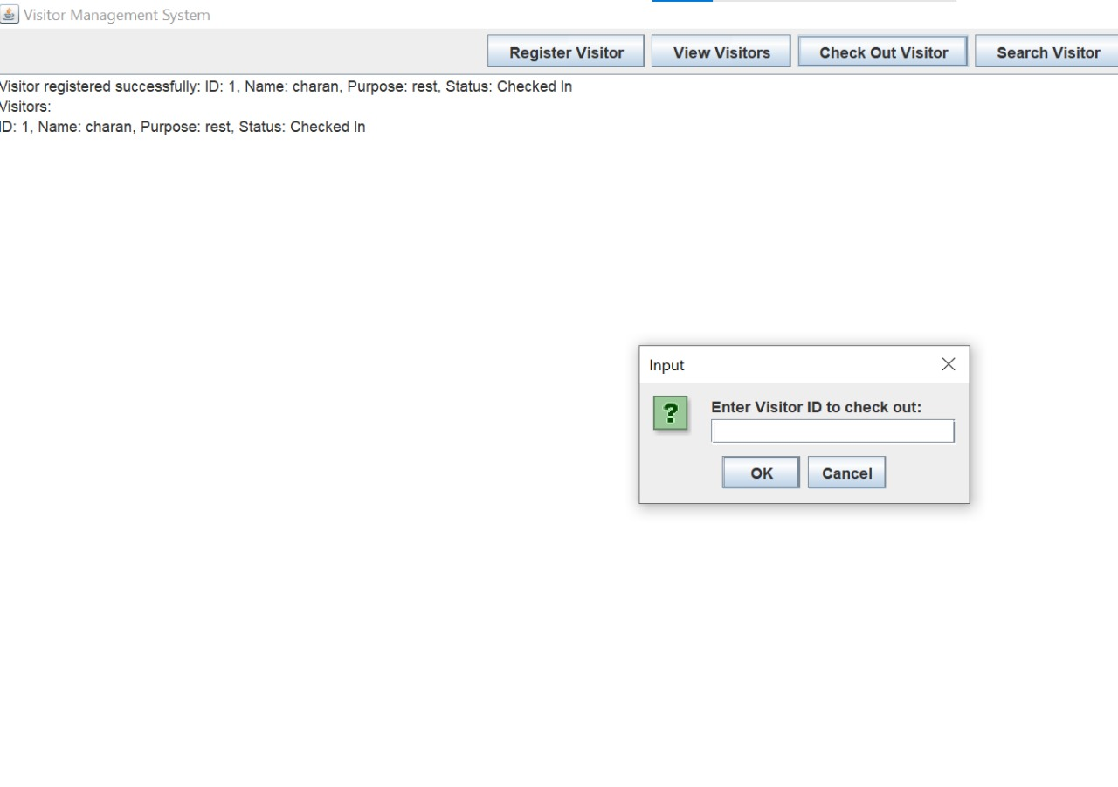
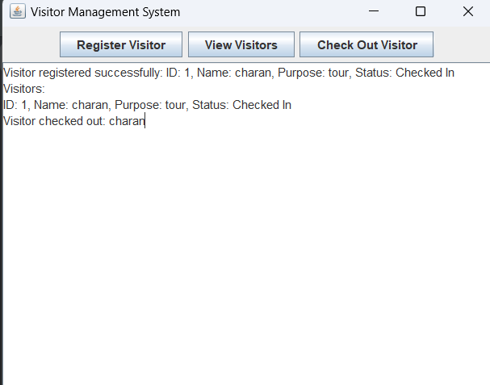
RESULTS AND DISCUSSION

Slide 11
QUERIES ?

